Slide 1




DOAP
Team Member:
Mentor:
Tilak Vaghasiya (IT146)
Prof. Viral H. Shah
IT Department ,(FOT)

Slide 2


DOAP – Digital Outdoor Advertising Platform
DOAP is a cloud-based platform revolutionizing outdoor advertising. It connects advertisers, screen owners, editors, and admins, streamlining the entire process from booking to content approval.

Slide 3

The Vision: Centralized and Simplified Outdoor Advertising
1
2
Streamlined Screen Discovery & Booking
Enhanced Ad Quality Control
Simplify the process of finding, reserving, and scheduling digital display screens across diverse locations.
Ensure high-quality content through dedicated editor support and thorough validation processes.
3
Automated Workflows
Automate pricing, availability checks, and booking confirmations for greater efficiency.

Slide 4
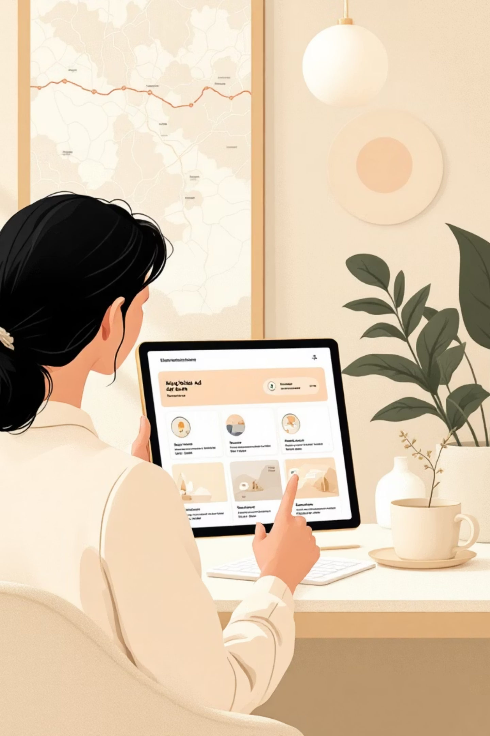


Comprehensive Project Scope
Interactive Screen Discovery: List and map views for easy navigation.
Secure Payment Processing: Ensure verified and secure transaction confirmations.
Robust Content Management: Upload, preview, edit, and approve advertisements seamlessly.
Role-Based Access: Tailored access for advertisers, screen owners, editors, and admins.
Cloud-Native Architecture: Fully cloud-based for scalable deployment and storage.
Intelligent Booking System: Schedule ads with built-in conflict prevention.

Slide 5




Why DOAP? Addressing Industry Challenges
Fragmented & Manual Processes
The current outdoor advertising landscape is plagued by manual operations and a lack of integration.
Lack of Transparency
Absence of clear pricing and real-time availability leads to inefficiencies and distrust.
Booking Conflicts & Quality Issues
Poor scheduling systems result in booking overlaps and inconsistent content quality.
Need for Scalability
A scalable, secure, and automated solution is essential for modern advertising demands.

Slide 6






Core Features & Functionality
Secure Authentication
Role-Based Access
Google Sign-In and robust authentication mechanisms.
Tailored permissions for Advertisers, Screen Owners, Ad Editors, and Admins.
Screen Management
Availability Calendar
Categorization and efficient management of advertising screens.
Clear visual indicators for screen availability (green for available, red for booked).
Ad Upload & Preview
Smart Booking
Seamless advertisement upload, preview, and editor support for quality control.
Booking system designed to prevent slot conflicts and optimize scheduling.

Slide 7


Advanced Features: Dynamic Pricing and Payment
Dynamic Pricing
Payment Verification & Booking Confirmation
Pricing automatically adjusts based on location, time slot demand, and other key factors, maximizing revenue and offering flexibility.
A secure and reliable system ensures all payments are verified and bookings are confirmed instantly, building trust and efficiency.

Slide 8

Non-Functional Requirements: Pillars of Reliability
High Availability & Scalability
Secure Access
Ensuring the platform remains operational and performs seamlessly under varying loads.
Robust authentication and authorization protocols to protect user data and platform integrity.
Data Integrity
Fast Response
Maintaining consistency and accuracy across all data points within the platform.
Optimized system performance for quick interactions and a smooth user experience.
Cloud Reliability
Maintainable Architecture
Leveraging cloud infrastructure for maximum uptime and dependable service delivery.
Designed for ease of maintenance and future enhancements, ensuring long-term viability.

Slide 9



Technology Stack: Frontend & Backend
Frontend
Backend
React.js: Dynamic and interactive user interfaces.
Spring Boot (Java): Robust and scalable application framework.
HTML, CSS, JavaScript: Standard web development foundation.
RESTful APIs: Efficient communication between frontend and backend.
Responsive UI: Seamless experience across all devices.
Role-Based Dashboards: Customized views for each user role.
AWS : Content validation and store content.
PostgreSQL: Reliable and powerful relational database.
Calendar & Map Interfaces: Intuitive tools for screen discovery and scheduling.
Google Sign-In: Secure and convenient authentication.
JWT Sessions: Secure user session management.
Rule-Based AI: Intelligent recommendation logic.
Server-Side Validation: Ensuring content quality and security.

Slide 10








Cloud Deployment Strategy
DOAP is designed for full cloud deployment, ensuring scalability, security, and high performance.
Fully Cloud-Based
Leveraging robust cloud infrastructure for all platform components.
Frontend Hosting
User interfaces deployed on scalable cloud infrastructure.
Backend Servers
Application logic hosted on secure cloud servers.
PostgreSQL Database
Managed database services in the cloud for optimal performance.
AWS S3 for Media
Advertisement media stored securely and scalably in AWS S3.
AWS Ecosystem
Built on a secure and scalable AWS architecture.

Slide 11


Future Enhancements: Expanding DOAP's Potential
Advanced AI Recommendations
Real-time Analytics & Reporting
Integrating sophisticated AI for hyper-personalized ad content and placement suggestions.
Providing instant insights into campaign performance and screen utilization.
Mobile Application
Automated Payout System
Developing native mobile apps for on-the-go access and management.
Streamlining payments to screen owners for greater efficiency.
Real-time Ad Playback Integration
Multi-language Platform
Synchronizing ad playback for dynamic and responsive campaigns.
Expanding accessibility with support for multiple languages.

Slide 12


Thank You

